Slide 1
Syllogisms: classical and modern aspects and key concepts
Dobrovolskyi Oleksii DA-92

Slide 2
Syllogisms
A set of statements called premises, which lead to one logical conclusion.
Is a deductive argument in which a conclusion is inferred from two premises.
If the premises are true (and we assume they are), then the conclusion must be true.
∴ The symbol means “Therefore”. It signals the conclusion.

Slide 3
Contains three parts
Major premis - premise containing the major term
Minor premise - premise containing the minor term
Conclusion - proposition that contains the major term and the minor term

Slide 4
Three syllogistic types
Categorical
Conditional
Disjunctive

Slide 5
Categorical
Is a deductive argument consisting of three categorical propositions that together contain exactyl three terms, each of which occurs in exactly two of the constituent propositions.
Is in standard form when its premises and conclusion are all in standard-form categorical propositions and are arranged in a specified order.
Enthymeme – an informally stated syllogism with an implied premise.

Slide 6
The conclusion is always used to identify the terms of the syllogism
Major term - it is the predicate of the conclusion - symbolizes by letter P for predicate
Minor term - it is the subject of the conclusion - symbolizes by letter S for subject
Middle term - cannot be found in the conclusion, appearing instead in both premises

Slide 7
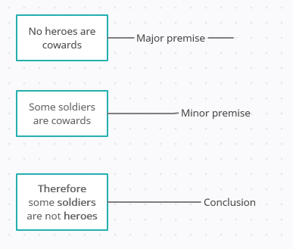
Example

Slide 8
Valid categorical syllogisms
“All fruits are plants. A peach is a fruit. Therefore, a peach is a plant.” - The term “fruit” is the middle term.
“All trees are plants. A redwood is a tree. Therefore, a Redwood is a plant.” - This categorical syllogism has three terms (trees, plants, and redwood)

Slide 9
Invalid categorical syllogisms
“All the people in the math classroom are students. Betty is in the math classroom. Therefore Fred is a student.” - A valid categorical syllogism may only have three terms, and this one has four (“All the people in the math classroom”, “students”, “Betty”, and “Fred”)
“Some Americans believe in UFO abductions. I am an American. Therefore, I must believe in UFO abductions.

Slide 10
Conditional syllogism
“If-then” syllogism
The minor premise must either affirm the antecedent or deny the consequent
If the minor premise affirms the antecedent, the conclusion must affirm the consequent.
If the minor premise denies the consequent, the conclusion must deny the antecedent.

Slide 11
Types
Affirming the antecedent - saying the “if” condition did in fact occur
Denying the consequent - saying the “then” part did not occur

Slide 12
Premises
In the major premise of a conditional syllogism, - The antecedent is the “if…” phrase - The “then…” phrase is a consequent
A conditional argument has a major premise with the form “If A, then B”, and is also knows as a hypothetical argument. It could be either a syllogism or an enthymeme.

Slide 13
Valid conditional syllogism
“If the sky is blue, there won’t be rain. The sky is blue today. Therefore, there won’t be rain.”

Slide 14
Invalid conditional syllogism
“If I drink beer then I will get fat. I drink beer. Therefore I am in good shape.”

Slide 15
Two fallacies involved
Denying the antecedent Ex. If you go to school, you will learn something. You do not go to school. You will not learn anything.
Affirming the consequent Ex. If you go to school, you will learn something. You learn something. You go to school.

Slide 16
Disjunctive syllogism
“Either-or” syllogism
Ex. Either you like Star Wars or Star Trek. You like Star Wars. You don’t like Star Trek.

Slide 17
Limitations of Syllogism
Formal correctness insufficient to gain adherence
Precise language essential to analyzing and appraising arguments
Certainly cannot always be established
Reasoning does not always follow three-liner form

Slide 18
Thank you!
Dobrovolskyi Oleksii DA-92

